Slide 1

CSG1105 / CSG5130
Applied Communications
Chapter 11
Network Management and Security

Slide 2
Objectives
Discuss the various elements of network management
Describe the elements of network security
Identify the main components of Disaster Recovery
Explain the characteristics of Storage Management
Differentiate between various encryption and authentication techniques
Describe the purpose of fault tolerance and tunneling
CSG1105 / CSG4130 Applied Communications

Slide 3
Network Management
Important task in a networked computer environment
  Function performed by:
    System administrator, network manager, or engineer
  Maintain current network view (status) through:
    Planning essential network elements and categories
    Record keeping
  Review and select new network technology
  Perform research and invest time for success
    Read trade magazines, attend conferences, and make friends with other IT professionals
CSG1105 / CSG4130 Applied Communications

Slide 4
Disaster Recovery
Computer lab or network operations center
  Many potential disasters
Disaster recovery
  Planning and methodologies
    Reduce or eliminate threats; recover from disaster
  Identify critical systems first
  Implement safeguards for quick, painless recovery
  Get business running again after disaster
  Includes Service Level Agreements (SLAs)
    Specific service level guarantees in the event of disaster
CSG1105 / CSG4130 Applied Communications

Slide 5
Disaster Recovery (cont’d.)
Business continuity plan
  Looks at long-term business operations
  Specifies alternate site use in the event of disaster
    Cold site: electricity, space for equipment, bathrooms
    Warm site: minimal networking hardware, no data
    Hot site: all equipment required, current data
Downtime affects accessibility over time
Operating systems include backup tools
  Full backup
  Incremental backup
  Differential backup
CSG1105 / CSG4130 Applied Communications

Slide 6
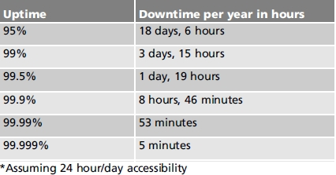
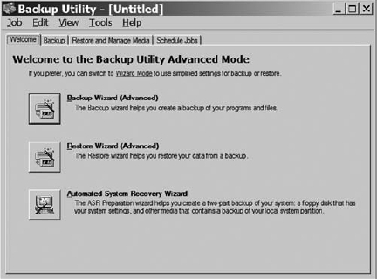
Disaster Recovery (cont’d.)
Table 11-1 Uptime* percentage
and its effect on downtime
Figure 11-3(a) Windows XP Backup Utility
CSG1105 / CSG4130 Applied Communications

Slide 7
Disaster Recovery (cont’d.)
Fault tolerance
  System ability to withstand hardware or software fault
    Keep functioning
Increase fault tolerance by:
  Having backup archives
  Using RAID drives
  Using redundant hardware
  Utilizing multiple, different Internet connections
Money spent on fault tolerance
  Worth the expense on networks requiring high reliability
CSG1105 / CSG4130 Applied Communications

Slide 8
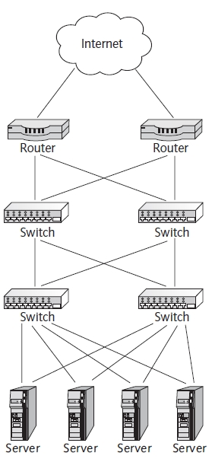
Figure 11-4 Fault-tolerant network topology
CSG1105 / CSG4130 Applied Communications

Slide 9
Disaster Recovery (cont’d.)
Protocol analyzers
  Report computer network traffic type and usage
  Quickly identify network problems
  Proactively monitor and plan future network growth
  Stand-alone hardware unit
    Connects to network or software program running on a network host
    Collects statistical network performance information
    Statistics converted into graphical real-time views
  RMON and RMON2 standards
    Provide packet capturing and protocol decoding support
CSG1105 / CSG4130 Applied Communications

Slide 10
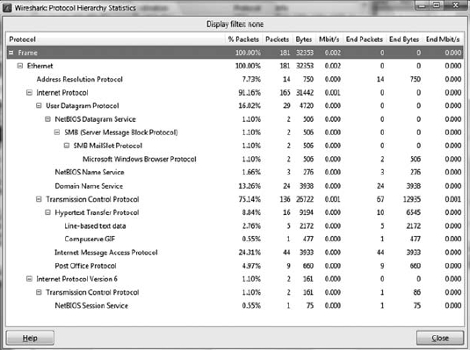
Figure 11-5 WireShark window showing protocol statistics
CSG1105 / CSG4130 Applied Communications

Slide 11
Disaster Recovery (cont’d.)
Simple Network Management Protocol (SNMP)
  Gathers statistics on a device-by-device basis
    Network devices categorized as managed
    Include hubs, switches, routers, and other network devices
  Agents gather network statistics
  Management stations report on data
  Popular due to its power, ease of use
    Four operations (GET, SET, GET-NEXT, TRAP)
  Three SNMP information categories define scope
    SNMP protocol, Structure of Management Information rules, Management Information Base
CSG1105 / CSG4130 Applied Communications

Slide 12
Network Security
Two categories
  Methods to secure data
  Methods to regulate data transmission
Threats
  Many types
    Interruptions
    Interceptions
    Modifications
    Fabrications
  Controlled by security measures
CSG1105 / CSG4130 Applied Communications

Slide 13
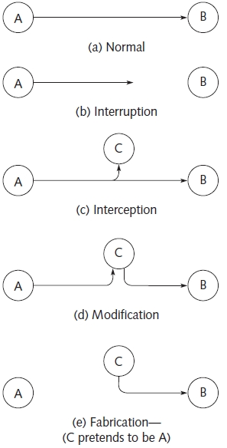
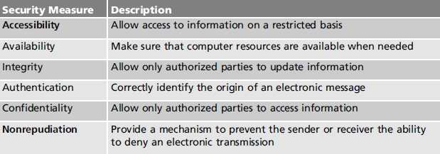
Table 11-3 Different types of security
measures
Figure 11-6 Typical information exchange scenarios between A and B
CSG1105 / CSG4130 Applied Communications

Slide 14
Network Security (cont’d.)
Viruses
  Software
    Enter computer system; corrupt the hard drive files
  Exhibit various behaviors
  Important to have system, user file backup archives
    Stored appropriately
  Four main category types
    Boot sector, file or program, macro, multipartite viruses
  Latest virus types: stealth, polymorphic, armored
  Also have worms, Trojan horses, and rootkits
CSG1105 / CSG4130 Applied Communications

Slide 15
Network Security (cont’d.)
Network sniffers
  Similar to protocol analyzer
  Capture and decode network traffic
    Passwords, trade secrets, and other proprietary information
  Operates in passive mode
    Device attached to the network
    Silently collects information
  One of the worst security breach types
    No one knows network security compromised
CSG1105 / CSG4130 Applied Communications

Slide 16
Network Security (cont’d.)
Plain-text encryption
  First line of defense in protecting network data
    Prevent plain-text password exchange on the network
  Prevents sensitive information disclosure
  NetBIOS plain-text encryption
    Not difficult to crack
    Provides easy, small measure of security to networked resources
CSG1105 / CSG4130 Applied Communications

Slide 17
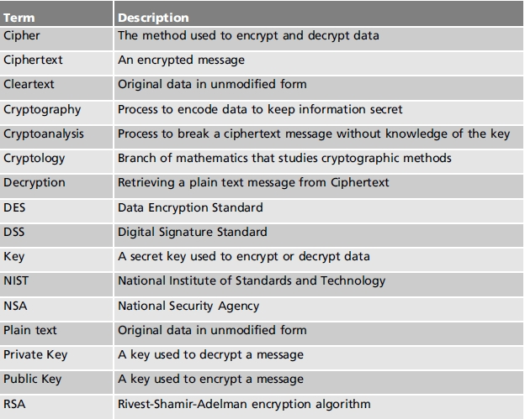
Table 11-4 Common terminology used in computer and
network security
CSG1105 / CSG4130 Applied Communications

Slide 18
Network Security (cont’d.)
Kerberos
  Uses secret-key ciphers for encryption, authentication
  Authenticates requests for network resources
    Does not authenticate document ownership
SSL
  Facilitates secure Internet communication
  Uses public key encryption
    Encrypts data before transmission
  Supported by most browsers
  Enabled when URL specifies https protocol
CSG1105 / CSG4130 Applied Communications

Slide 19
Network Security (cont’d.)
Public-key encryption
  Public key
    Encrypts transmitted
  Private key
    Decrypts data
  Eliminates problem when same key used to encrypt and decrypt data
  More secure data encryption and decryption method
    Public key posted for public access
    Private key guarded very carefully
CSG1105 / CSG4130 Applied Communications

Slide 20
Network Security (cont’d.)
Certificates of authority
  Guarantee e-mail sender’s identity
  Available for enterprises, small businesses, and home use
  Provides opportunities:
    Manage Web site domain names, server certificates
    Safeguard network resources using public-key encryption
    Secure network applications (e-mail, messaging)
    Enable e-commerce applications supporting online payments, purchases
CSG1105 / CSG4130 Applied Communications

Slide 21
Network Security (cont’d.)
Pretty Good Privacy (PGP)
  Provides confidentiality and authentication services
    Used with electronic message, file storage applications
  Important elements:
    Uses best cryptographic algorithms
    Unlimited source code, documentation distribution
    Not controlled by government, standards organization
  Support mechanisms
    Digital signatures, message encryption, compression
    Transparent compatibility with many application programs
CSG1105 / CSG4130 Applied Communications

Slide 22
Network Security (cont’d.)
Masquerading
  Spoofing attacks
  IP masquerading (IP spoofing)
  One computer forwards information from one or more other computers
    Using IP addresses not officially assigned
Firewalls
  Hardware device or software program
    Examines information packets
    Determines if communication exchange occurs
  Packet-filtering, proxy-service, stateful-inspection
CSG1105 / CSG4130 Applied Communications

Slide 23
Network Security (cont’d.)
Virtual LANs (VLANs)
  Partitioning VLAN-capable switch ports into LAN groups
    Isolates traffic
Intrusion Detection Systems
  Combines traffic sniffing with analysis techniques
  Network-based Intrusion Detection (NIDS)
    Centralized approach
  Host-based Intrusion Detection (HIDS)
    Decentralized approach
CSG1105 / CSG4130 Applied Communications

Slide 24
Network Security (cont’d.)
Proxy Server
  Server-type application program
    Sits between a user workstation and the Internet
    Monitors, logs network activity
  Used with a gateway to isolate LAN from the Internet
  Used with a firewall to protect network from intruders
IP Security (IPSec)
  Secures communications across a LAN, between public, private networks, across the Internet
  Incorporated into TCP/IP protocol stack
    Below UDP, TCP transport protocols
CSG1105 / CSG4130 Applied Communications

Slide 25
Network Security (cont’d.)
Tunneling
  Uses public network infrastructure
    As part of a Virtual Private Network
  Data encapsulated
    Encrypt original source address, destination address, payload data
Layer 2 Tunneling Protocol (L2TP)
  Combination of protocols
    Point-to-Point Protocol (Microsoft)
    Layer 2 Forwarding Protocol (Cisco)
  Standard tunneling protocol for VPNs
CSG1105 / CSG4130 Applied Communications

Slide 26
Network Security (cont’d.)
Denial-of-Service Attacks (DOS attack)
  Prevents legitimate users from using a service
    Essentially disables a computer or network
  Three basic attack types:
    Consumption of limited resources
    Destruction or alteration of configuration files
    Physical destruction or modification of network components
Hardening
  System: process vulnerabilities reduced or eliminated
    Network: operating systems and application hardening
CSG1105 / CSG4130 Applied Communications

Slide 27
Storage Management
Network Attached Storage (NAS)
  High-capacity file storage directly connected to the network
  NAS devices characteristics:
    May use hard drives or writable CD-DVDs to store data
    Fault tolerance possible using RAID technology
    Communication via TCP/IP and IPX/SPX
  Storage Area Network (SAN)
    Uses a special switch to connect servers, storage devices on their own physical network
    One server acts as a gateway to the SAN
CSG1105 / CSG4130 Applied Communications

Slide 28
Storage Management (cont’d.)
User management
  Areas to consider
    Acceptable Use Policy
    Logon Policy
    Password Policy
    Access Control
    Security Awareness Training
    Auditing Policy
    User Termination Policy
  All areas require enforcement
CSG1105 / CSG4130 Applied Communications

Slide 29
Troubleshooting Techniques
Network management
  Requires patience and determination
  Several different possible troubleshooting choices
    Each choices may provide a workable solution
    No one choice better than the others
Network security
  May involve significant research
  Requires a good normal system activity baseline
  Most important tool
    System activity log
CSG1105 / CSG4130 Applied Communications

Slide 30
Summary
Network management
  Managing network technologies to provide a cost-efficient, reliable, and secure computer network
Disaster recovery
  Planning and methodologies
    Reduce or eliminate threats
    Recover when disaster occurs
Network security
  Methods used to secure data
  Methods used to regulate transmitted data
CSG1105 / CSG4130 Applied Communications

